Slide 1
Miscellaneous Credits
Pub 4012 Tab G
Pub 17 Part 6
(Federal 1040-Lines 51, 53 & 54)
Notes:
1

Slide 2
Review: Nonrefundable Credits
Dollar for dollar reduction of tax liability
Applied against federal tax in the order they are listed on Federal 1040 Page 2 credits
Amount of credit could change in TW if entry of a credit on prior line causes nonrefundable credits to exceed tax liability
Can reduce tax liability to zero
Note: Refundable credits covered elsewhere
Notes:
2

Slide 3
Nonrefundable Credits
Education Credits – 1040 Line 50
Must be entered at end of return after all other figures finalized and Diagnostics run, so covered in a later module
Retirement Savings Contributions Credit – 1040 Line 51
Residential Energy Credits – 1040 Line 53
Credit for the Elderly or Disabled – 1040 Line 54
Others which are Out Of Scope –
Alternative Motor Vehicle Credit
Mortgage Interest Credit
Notes:
3

Slide 4
Retirement Savings Contribution Credit
Pub 4012 Tab G
Credit for contributing to a retirement plan-IRA, 401k, 403b, 457b, etc.
Amount of credit based on AGI & filing status
TW automatically inserts Form 8880, if taxpayer qualifies & if:
Traditional or Roth IRA contribution is entered on Federal 1040 Line 32
Form W-2 includes retirement contribution in Box 12 with a code designation of D, E, F, G, H, S, AA, BB or in Box 14 marked as “Qualifies for Form 8880”
Notes:
414h Withholding does not count for Retirement Savings Credit. 414h plans mandate “employee contributions” which the employer then pays. Not included in taxable wages, so taxpayer already gets a tax benefit. Therefore, cannot also take a Retirement Savings Contribution Credit
4

Slide 5
Retirement Savings Contribution Credit
Pub 4012 Tab G
(cont’d)
2014 contribution reduced by any retirement plan distributions to taxpayer after 2011 thru due date of 2014 return (IRA, Roth, 401k, etc.) *
Must complete TW Form 8880
Must answer questions in red at top of page
Must enter retirement plan distributions next to appropriate year (if any) & indicate if filed MFJ
TW completes rest of form
TW calculates credit on Form 8880 Line 14 & transfers to Federal 1040 Line 51
Wait until return is complete – may show up as red in tree during entry, but only need to complete if red at end (credit still applies)
* Consult Pub 4012 Tab G to determine which retirement plan distributions to include/exclude
Notes:
5

Slide 6
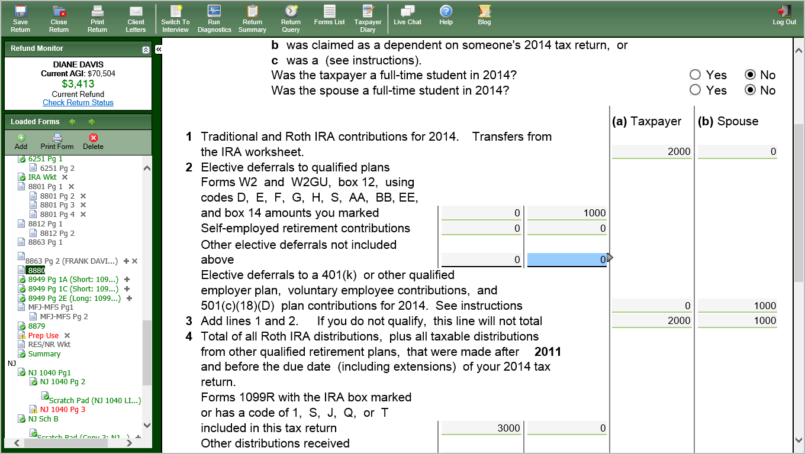
TW Retirement Savings Contribution Credit – Form 8880
Pub 4012 Tab G
Answer questions in red
Enter retirement plan
distributions by year
Notes:
6

Slide 7
Residential Energy Credits
Applies to qualified energy efficiency improvements
Insulation, windows & doors, qualifying metal / asphalt roofs (does not include labor costs)
Most standard new roofs are NOT qualifying roofs
Heating & air conditioning systems (includes labor costs)
See Form 5690 for complete list of items
Improvements made to principal residence only (must be existing home)
Improvements placed into service in current Tax Year
Notes:
7

Slide 8
Residential Energy Credits
(cont’d)
Total combined credit limit of $500 for all years after 2005 ($200 for windows)
Maximum credits:
$50 for advanced main air circulating fan
$150 for natural gas, propane, oil furnace
$150 for hot water boiler
$200 for windows
$300 for any item of energy-efficient building property
Notes:
8

Slide 9
Residential Energy Credits
(cont’d)
Credit taken on Form 5695, Part II
Form 5695, Part I, Out of Scope
For alternative energy equipment, such as solar hot water heaters, geothermal heat pumps, & wind turbines
NOTE: Not all ENERGY STAR products qualify for credit. Manufacturers must certify & provide written statement
Notes:
9

Slide 10
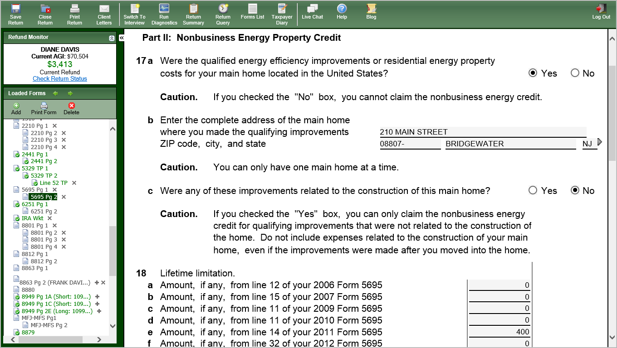
TW Residential Energy Credits – Form 5695 Page 2 Part II
Energy credits taken in prior years
Notes:
Read & answer questions carefully on Form 5695 Page 2. Page 1 is for solar & geothermal improvements (Out of Scope)
10

Slide 11
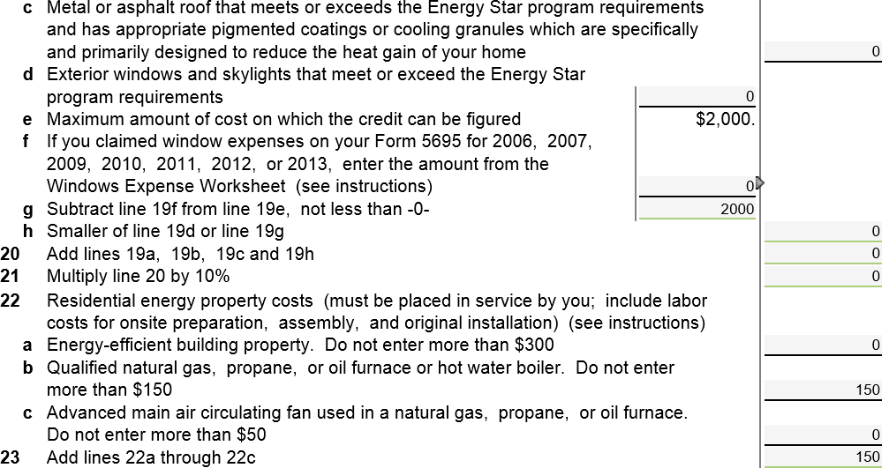
TW Residential Energy Credits – Form 5695
(cont’d)
Expenses for current tax year. Do not include installation costs
Enter amounts for energy improvements on appropriate lines.
Follow instructions on when to include labor costs
Notes:
Must enter energy credit amounts from 2006 – prior tax year Form 5695. If total is >/= $500, taxpayer cannot claim current tax year credit
Since this is a nonrefundable credit, amount claimed cannot be greater than tax liability when added to other nonrefundable credits
Enter appropriate energy improvement costs on Lines 19a – d & 22a - c.
Be careful to determine which labor costs can be included, depending on type of improvement. Instructions for Lines 19 & 22 specify if labor can be claimed
If credits for windows claimed in 2006-prior tax year, must complete Windows Expense worksheet & enter amount on Line 19f
Lines 22a – c tell you maximum that can be claimed
11

Slide 12
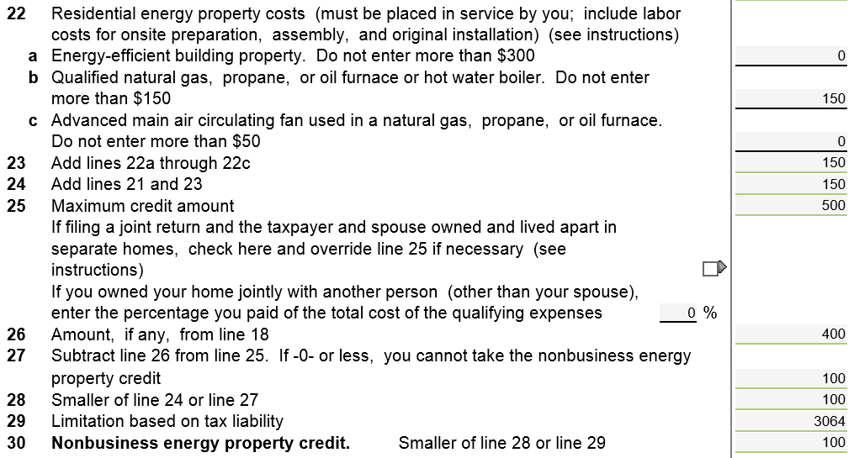
TW Residential Energy Credits – Form 5695
(cont’d)
Expenses for current tax year.
Include installation costs
Maximum credit
Credits claimed for prior years
Amount still available
Current tax year credit allowed
Notes:
After credits from prior years & current tax year expenses are entered, TW calculates the rest of this form
Lines 20 & 23 show the amounts spent in current tax year
Line 25 shows the maximum credit amount
Line 26 shows the credits claimed for prior years
Line 27 shows amount still available (maximum credit minus credits taken in prior years)
Line 30 shows current tax year credit. TW transfers to 1040 Line 53
12

Slide 13
TW Residential Energy Credit – Federal 1040 Line 53
TW transfers from Form 5695
Notes:
TW transfers Form 5695 Line 30 to 1040 Line 53
13

Slide 14
Eligibility for Credit For The Elderly or Disabled
Pub 4012 Tab G
At least 65
If under 65 & retired on permanent & total disability & did not reach mandatory retirement age - must have taxable disability income
Must meet income limits for AGI & non-taxable SS/pension benefits – dependent on filing status
Rare due to severe income limitations
Requires Schedule R
TW computes automatically if correct data is input
Notes:
Refer to Pub 4012 Tab G for eligibility decision tree & income limits chart
14

